Slide 1

Towards Securing 5G Networks
Prof. Vireshwar Kumar

Slide 2
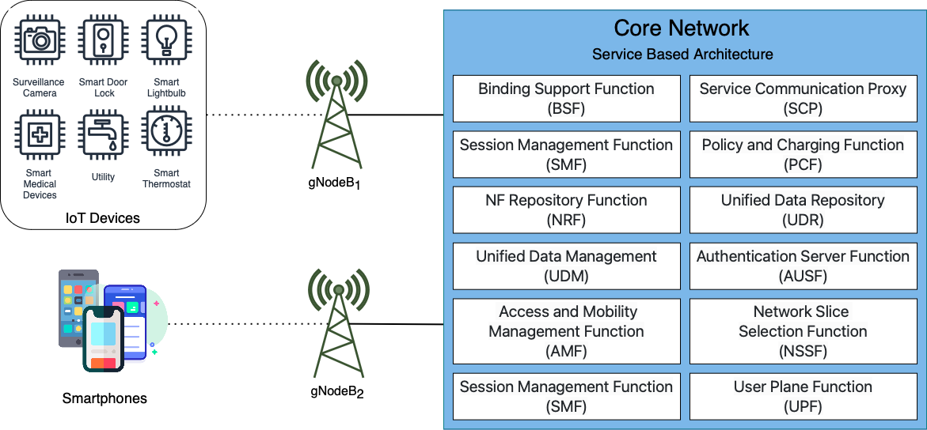
Fifth Generation Cellular Networks

Slide 3
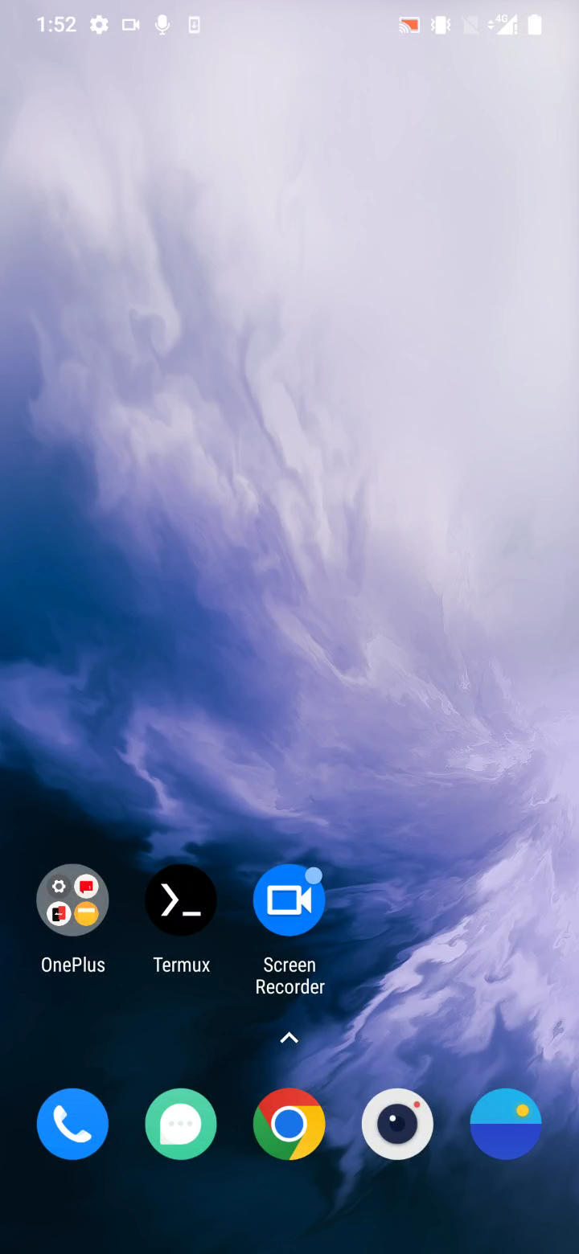
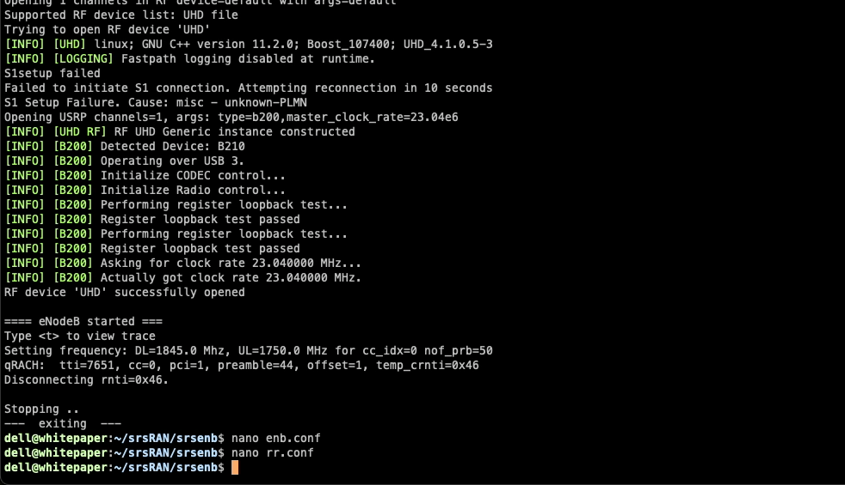
Registration (Hardware Deployment)

Slide 4
Hands-on Demo
github.com/priyanshs/innog-demo

Slide 5
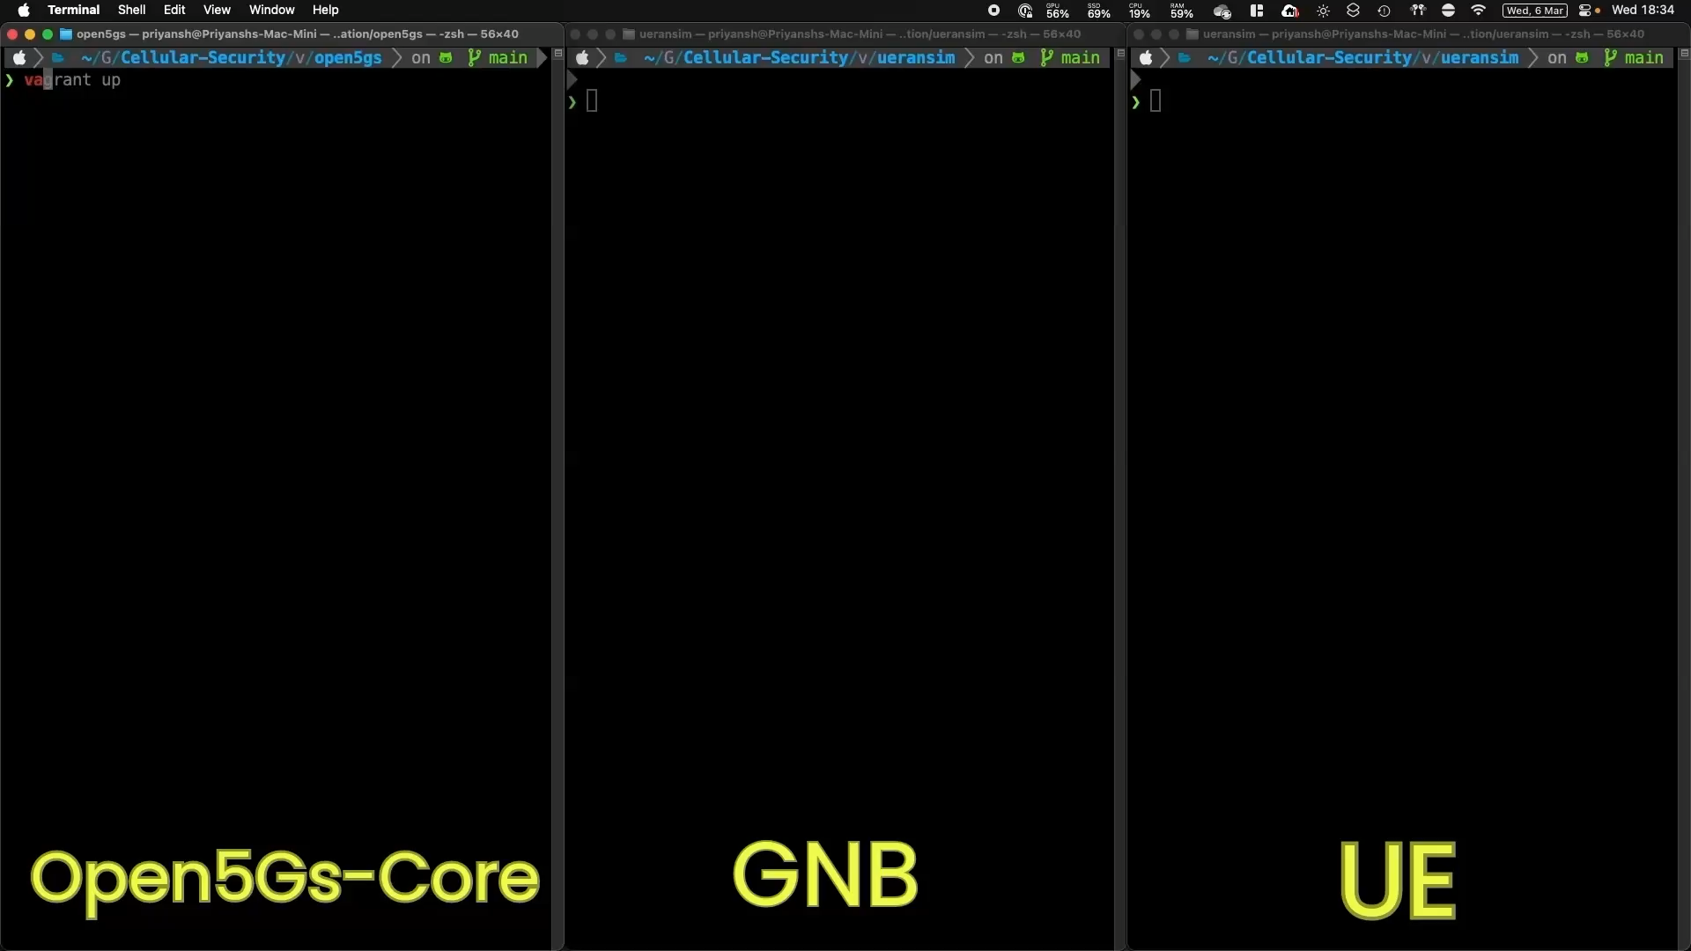
Registration (Software Simulators)
https://youtu.be/SAvNui838Sw

Slide 6
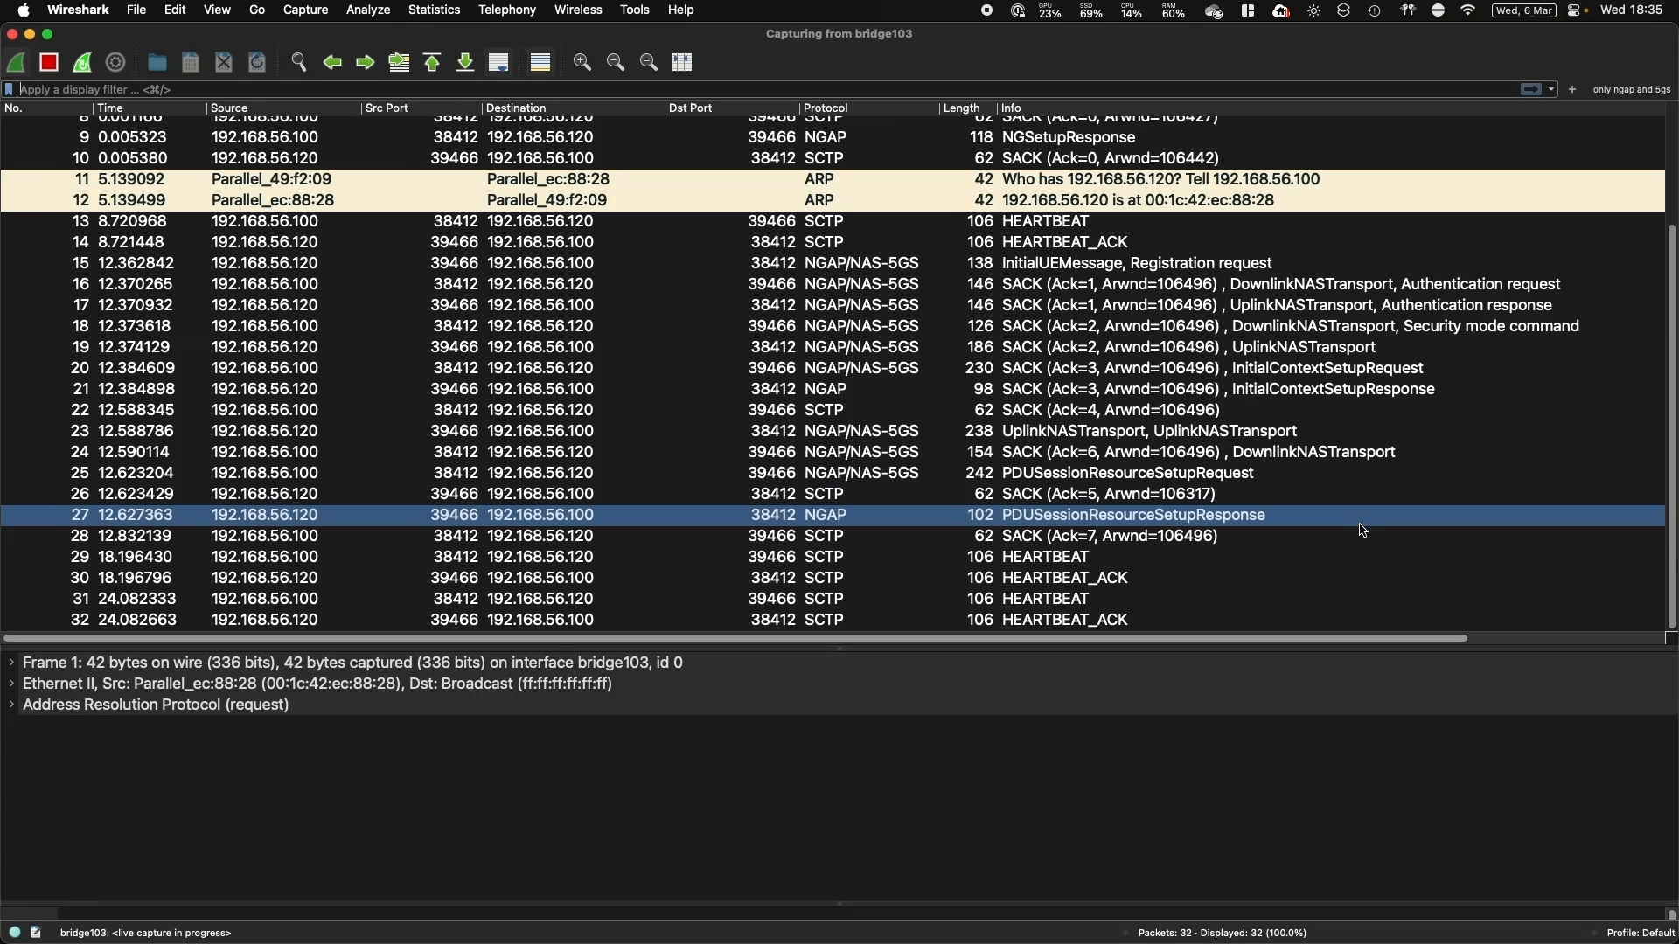
Realistic Application Traffic Capture
https://youtu.be/SAvNui838Sw

Slide 7
5G Authentication and Key Management

Slide 8
Subscriber Private Identity Concealment

Slide 9
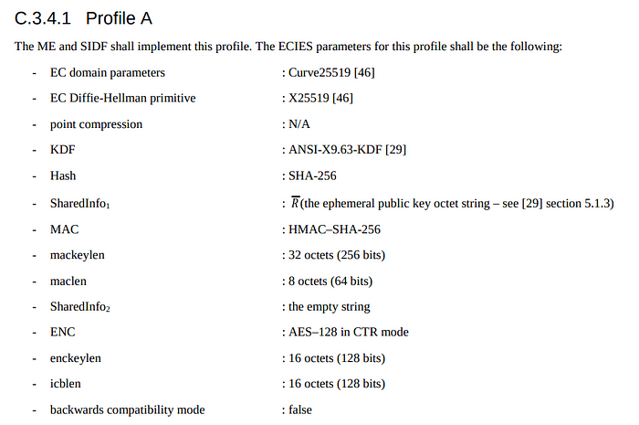
Subscriber Private Identity Concealment
Procedure | User Equipment | Core Network
Shared Key Generation | 1 ANSI-X9.63-KDF Operation | 1 ANSI-X9.63-KDF Operation
Generate K_{enc}, K_{MAC} | 1 SHA-256 Operation | 1 SHA-256 Operation
Encryption/Decryption | AES-128 | AES-128
MAC Generate | 1 HMAC-SHA-256 | -
MAC Verify | - | 1 HMAC-SHA-256
3GPP TS 23.502, Procedures for the 5G System (5GS), Annexure C

Slide 10
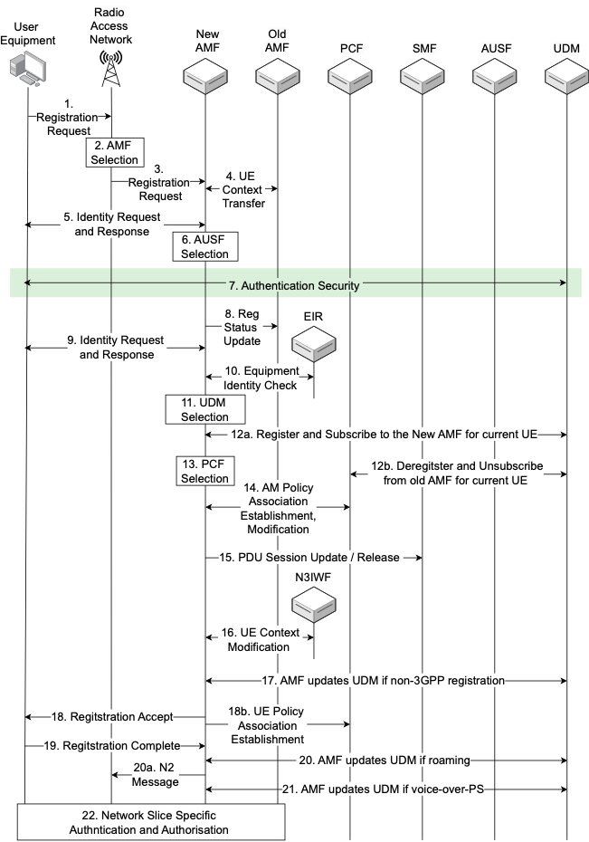
Registration

Slide 11
Registration

Slide 12
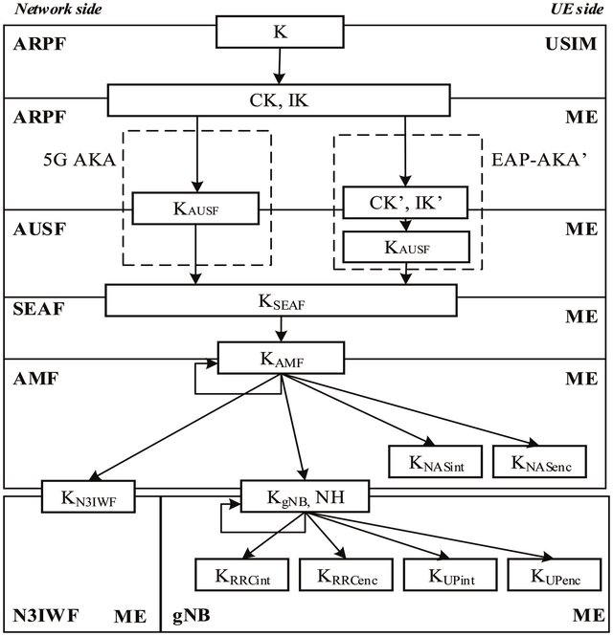
Key Generation During Registration

Slide 13
Thank You

